Slide 1
Breast Cancer Classification
Machine Learning Capstone Project
Predicting Malignant vs Benign Tumors
PREPARED AND PRESENTED BY:
ANDERSON MTAWALI AND PETER KIGANYA MBURU

Slide 2
Problem Statement
What are we solving?
Automated classification of breast tumors as Benign or Malignant based on cell measurements
Why does it matter?
Breast cancer is one of the most common cancers affecting women worldwide
Early and accurate diagnosis significantly improves survival rates (99% for early detection)
Manual diagnosis can be time-consuming and subjective
Real-world impact:
Assists medical professionals in making faster, data-driven decisions
Reduces diagnostic errors and improves patient outcomes
Supports screening programs in resource-limited settings

Slide 3
Step 1: Data Source
Data Source:
Breast Cancer Wisconsin (Diagnostic) Dataset
UCI Machine Learning Repository
Dataset Characteristics:
569 samples (357 Benign, 212 Malignant)
30 numeric features derived from digitized images of Fine Needle Aspirate (FNA)
Features computed for each cell nucleus: radius, texture, perimeter, area, smoothness, compactness, concavity, concave points, symmetry, fractal dimension
Each feature has 3 measurements: mean, standard error (SE), and worst (largest value)
Target Variable:
Diagnosis: M (Malignant) or B (Benign)

Slide 4
Step 2: Data Preparation
Data Cleaning:
Removed unnecessary columns: 'id' (patient identifier) and 'Unnamed: 32' (empty column)
Verified no missing values in the dataset
Data Encoding:
Converted categorical target variable to numeric:
  B (Benign) → 0
  M (Malignant) → 1
Outlier detection:
We detected outliers in the data set and we dropped them.

Slide 5
Step 3: Exploratory Data Analysis
Analysis Performed:
1. Class Distribution Analysis
Examined balance between Benign and Malignant cases
Found moderate imbalance (62.7% Benign, 37.3% Malignant)
2. Feature Correlation Analysis
Identified features most correlated with diagnosis
Analyzed multicollinearity among features
3. Statistical Analysis
Computed descriptive statistics grouped by diagnosis
Identified significant differences in feature distributions

Slide 6
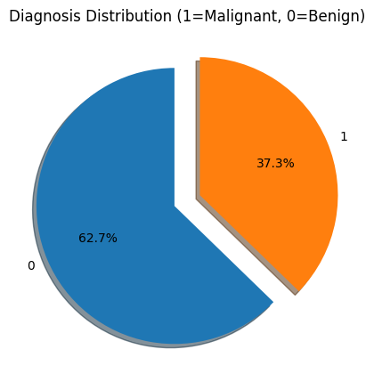
Class Distribution Visualization

Slide 7
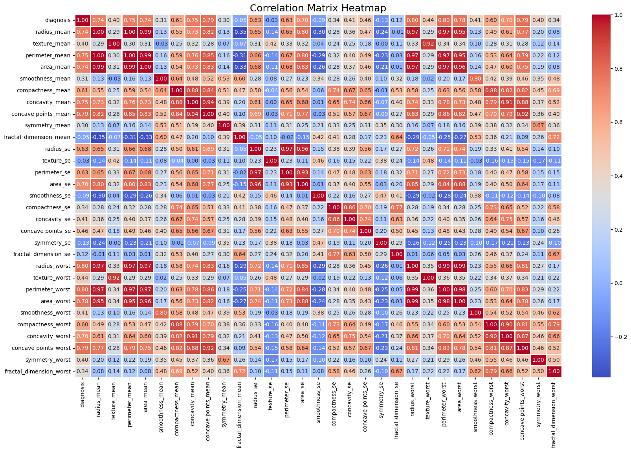
Feature Correlation Analysis

Slide 8
Step 4: DATA PREPROCESSING
Preparation of data for model building:
To prepare the data, we first dropped 7 features that were highly correlated after checking for correlation and we remained with 23 features for predictions.
We fixed the class imbalance using SMOTE technique which is (Synthetic Minority Oversampling Technique) which creates new synthetic samples for the minority class where it finds its nearest neighbour and generate new points between them.
Feature scaling, we performed standardization of the data so that the features share a similar range so as to prevent variables with larger values dominate the model.
We also split the data into 80% for training and reserve 20% for testing the performance of the model.

Slide 9
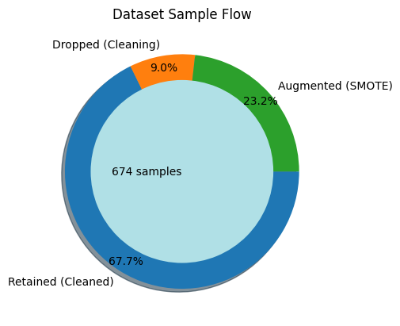
The graph displays the overall data usage for this project

Slide 10
Step 5: MODEL BUILDING
We build 4vdifferent models for this project that is Logistic regression, Random Forest, XGBoost classifier and CatBoost Classifier and choose the best model based on the accuracy values. Logistic regression performed quite well wiih high accuracy score compare to the three of them.
┌───────────────────────────────
│ MODEL │ ACCURACY
├───────────────────────────────
│ Logistic Regression │ 0.985185 │
│ XGBoost │ 0.970370 │
│ CatBoost │ 0.970370 │
│ Random Forest │ 0.955556 │
└───────────────────────────────

Slide 11
Model selection
After checking the accuracy of the model, we decided to select XGBoost classifier over logistic regression since the accuracy of logistic regression was almost 99% which can lead to overfitting and also logistic regression has the limitation generalizing and can cost us with missclassification. The other strength of XGboost classifier is that it can capture complex non linear patterns and it is robust. The field of medical diagnosis is sentitive and it needs robust models for accurate predictions.

Slide 12
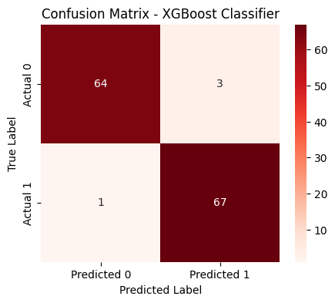
Model prediction
The confusion matrix shows the actual vs the predicted values. This shows how the values were predicted and we can also get the accuracy of the model also.

Slide 13
Conclusion & Impact
Summary:
The Dataset was quiet small totalling around 569 samples &after preprocessing 9% of the data samples were dropped. The samples were slightly imbalanced after processing, hence SMOTE Technique was applied on the data to balance the classes, adding 23.2% more samples to the dataset. Visualising the distribution of data & their relationships, helped us to get some insights on the relationship between the feature-set. Feature Selection/Eliminination was carried out and appropriate features were shortlisted.Testing multiple algorithms with fine-tuning hyperparamters gave us some understanding on the model performance for various algorithms on this specific dataset.
Conclusion
After preprocessing the dataset with SMOTE and selecting the most relevant features, we tested multiple models to understand their performance. Although Logistic Regression showed high accuracy, the problem required deeper pattern detection. We therefore chose XGBoost, as it minimizes misclassification risks in this sensitive field.

Slide 14
Future Work & Improvements
Next Steps:
Model Enhancement:
Hyperparameter tuning using GridSearchCV or RandomizedSearchCV
Test additional algorithms: SVM, Neural Networks…..
Feature Engineering:
Feature selection to identify most important predictors
Dimensionality reduction (PCA) for efficiency
Deployment:
Create web application for easy access
Develop API for integration with medical systems
Mobile app for point-of-care diagnosis

Slide 15
END
Thank You
I welcome any questions

